Slide 1
fallacies
of the internet
CRE 101
Jester Lumos

Slide 2
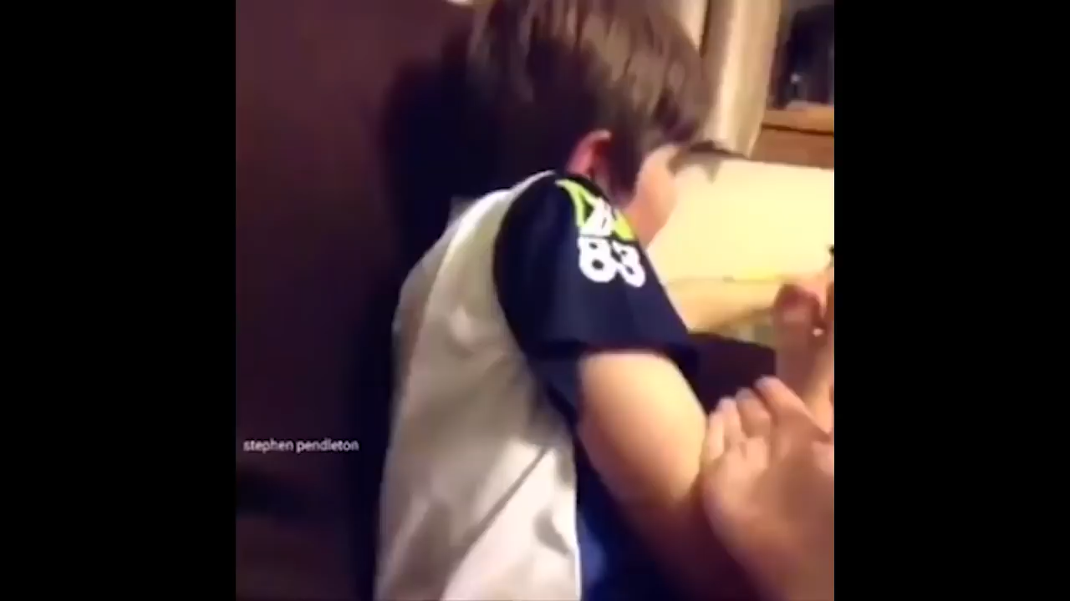

i thought you were American.
Originally posted to .
Unattributed
1

Slide 3
False Dichotomy
Two categories are presented as mutually exclusive, but they are not.
A
B
Author’s Reasoning
Conclusion: Not American
Reason: Lesbian
You can’t be American if you are
lesbian.
American or lesbian
Not mutually exclusive
Presented either-or
1
Notes:
This is an example of a false dichotomy, or, as ARQ words it, an “either-or” fallacy. Let’s examine the child’s reasoning in this clip. The child is implied to begin the interaction believing the cameraperson to be American. The only new information the child receives during the conversation is that the cameraperson is lesbian. This means that the child has decided the cameraperson cannot be an American if they are lesbian. People can be EITHER American OR lesbian, but not both. The last task in analyzing this reasoning is to determine if the dichotomy holds true or not.

Slide 4
Intended Audience
Vine was a short-form video platform, mostly populated with children. Users sought entertainment, not argumentative structure.
Children
Entertainment
Potential Impact
No malicious intent in the video, but it still represents a dangerous format.
Not malicious
Dangerous concept
1
Notes:
Because of the demographics of the platform the video was originally posted to, we can deduce that the video is targeted at children who are not engaged in critical thinking. Because of this targetting, the concept of this format is very concerning. The idea of targetting disengaged children with fallacious reasoning on entertainment platforms represents a direct threat of propaganda and misinformation informing subconscious biases that carry into adult life. That said, this particular video is mostly free of any malicious intent. The only real impact here was on internet history.

Slide 5

yeah but that backflip.
Originally posted to .
King Bach
2

Slide 6
Red Herring
Irrelevant information is used to distract from something important.
Author’s Reasoning
Conclusion: Forget your purse
Reason: That backflip
That backflip is what you should worry about, not your purse.
Her purse is important.
The backflip is a distraction.
The backflip is irrelevant.
2
Notes:
A red herring fallacy happens when someone tries to distract from a point with irrelevant information rather than reasoning through it. In this case, we know what is important in the situation because the skit opens with the woman’s purse getting stolen. We know that King Bach is trying to distract the woman from this point because he comes between her and the object of her concern, and then changes the subject back to himself and his backflip when she attempts to voice those concerns. Finally, the backflip is completely irrelevant to the woes of purse thievery, so we can conclude that King Bach uses a red herring fallacy to avoid addressing the stolen purse.

Slide 7
Intended Audience
Vine was a short-form video platform, mostly populated with children. King Bach ran a comedy skit page on the app.
Children
Comedy context
Potential Impact
There is a fine line when targeting children, but within the context, this was generally understood as a joke and not taken at face value.
Fine line
Commonly Understood
Clear in context
2
Notes:
Similarly to the “I thought you were American” example of a false dichotomy or “either-or” fallacy, this video was distributed on the same platform to the general audience. However, this video was notably made explicitly clear as a comedy skit from a widely-known comedy account on the app (in fact, King Bach was actually the most popular user on the app when it closed down). This additional context made it clear that the video was not meant to be taken at face value, and thus it poses a much smaller danger to impressionable audiences.

Slide 8


caaaandy mouuuuuntain!
Originally posted to .
FilmCow
3

Slide 9
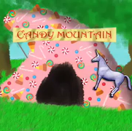
Appeal to Emotion
Emotional manipulation is used to distract from something important.
Author’s Reasoning
Conclusion: Go in the cave
Reason: Singing candy
Listen to our musical number and forget that this is a bad idea.
Charlie’s fears are real.
It’s just a distraction.
They promise joy.
3
Notes:
Similar to a red herring, an Appeal to Emotion involves using emotional manipulation to distract from a point instead of addressing it. Emotional manipulation in this sense is anything designed for the sole purpose of eliciting an emotional response from others. In this case, the Candy Mountain Cave is just a distraction designed to make Charlie either excited enough to forget his better judgement or annoyed enough to just want to get it over with. In either case, they don’t raise any actual points, and instead simply attempt to elicit an emotional response from Charlie to get him to do what they want.

Slide 10
Intended Audience
This video was posted during the early days of YouTube as an animated comedy video with unicorns, marketed towards children.
Early YouTube
Childhood aesthetic
Potential Impact
This video was representative of the “brainrot” crisis my generation experienced, and relatively tame for the videos we lived on with unfettered internet access as children.
“Brainrot”
Tame
Open internet access
3
Notes:
This video was published in the early days of YouTube with cartoon characters, whacky plotlines, trippy voices, and nonsensical music numbers. It was another in a long line of this style of video targeted at my generation as small children. Recent studies on more topical examples like “CocoMelon” have actually shown significant cognitive detriments to this style of content, and it was among the more tame types of media we gorged ourselves on with free internet connections and a need to entertain ourselves by any means at all hours of every day.

Slide 11
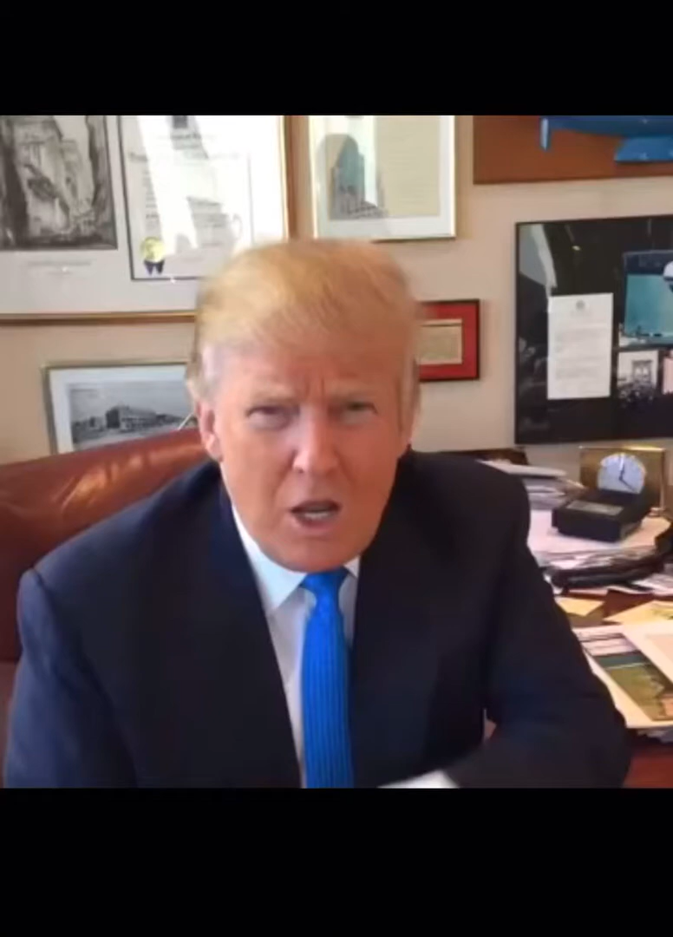
it’s disgusting!
Unsourced
Donald Trump (2015)
4

Slide 12
Ad Hominem
An opponent’s character or actions are attacked, instead of the opponent’s rhetoric.
Author’s Reasoning
Conclusion: Vote for me
Reason: Obama chews gum
Don’t vote blue because Obama chews gum.
Attacks Obama
No reasons.
4
Notes:
An ad hominem fallacy simply involves personal attacks against an opponent, so this is one of the easiest to analyze for. Instead of criticizing Hillary Clinton’s policies, he attacked the sitting president’s character (although, admittedly, in a ridiculous manner).

Slide 13
Intended Audience
Donald Trump was a presidential candidate right before an election, attacking the sitting president with appeals to traditional values.
Political
Traditional values
Potential Impact
These audiences are fairly susceptible, and the stakes involved the outcome of a U.S. presidential election, so the impact could have been massive.
Susceptible audience
High-stakes election
Unknown impact
4
Notes:
Because of Donald Trump’s status at the time as a presidential candidate and the proximity to the election, we can conclude that this was most likely a campaign effort. This means that the goal is to affect the outcome of the election by persuading more voters in his favor, which means the audience is 2016 voters. More specifically, it likely targeted moderate voters with strong connections to traditional values and moral sensibilities.
These audiences have historically proven to be fairly susceptible to these tactics, and the stakes were quite high if this potentially influenced the result of a U.S. presidential election, but there is unfortunately no good way to determine just how much impact it actually had, if any.

Slide 14

a bag o’ weed
Aired on FOX
Seth MacFarlane (2009)
5

Slide 15
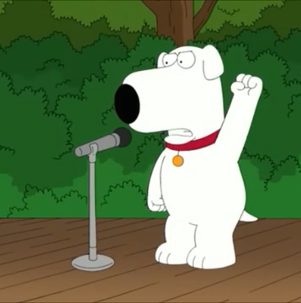

Glittering Generality
Vague ideals are evoked instead of reasons to support the reasoner’s conclusion.
Author’s Reasoning
Conclusion: Legalize weed
Reason: Buzz words sound good
Legalize weed because oppression, free will, profiteering!
Buzz words abused.
No reasons.
5
Notes:
Similarly to the ad hominem fallacy, a glittering generality is easy to spot by simply watching out for meaningless key phrases that evoke strong emotional contexts. In this case, words and phrases such as “free will,” “we have the right,” and “no more oppression” signal that Brian is using glittering generalities rather than logically sound rhetoric to argue his case.

Slide 16
Intended Audience
Brian’s ideal audience is undecided voters on the issue of marijuana legalization, but he ends up targeting… a park at noon.
Undecided voters
Parkgoers
Potential Impact
The impact of Brian’s statements alone would’ve been inconsequential. His target audience is minimally susceptible to these tactics and scarce at this location.
Low impact
Resistant audience
Poor location choice
5
Notes:
Unsurprisingly, Stewie Griffin ends up having to intervene and utilize more effective fallacious propaganda. This is because Brian chose his target audience and reasoning strategy poorly. Not many undecided voters are going to happen to walk past in the park, and those who do are unlikely to be swayed by a dog shouting vague buzzwords at them as they pass.

Slide 17
that’s enough of the internet!
Thanks!
Go away now.

